Slide 1
Cloud Caching
By Paul Prabakar

Slide 2
Cloud Caching Service
In computing, a cache /ˈkæʃ/ KASH, is a hardware or software component that stores data so future requests for that data can be served faster; the data stored in a cache might be the result of an earlier computation, or the duplicate of data stored elsewhere.
In computing, a distributed cache is an extension of the traditional concept of cacheused in a single locale. A distributed cache may span multiple servers so that it can grow in size and in transactional capacity. It is mainly used to store application data residing in database and web session data.

Slide 3
In-memory Cache Use Cases
Database Offloading
In case of slow database or disk access
Web Content Caching
In case of high latency and / or narrow bandwidth to actual servers
Low Latency Data Access
For time critical operations
Pub / Sub Operations
For multiple services and multiple consumers
Message Queues
Distributed Network Message Passing Mechanisms
CDN Caches
In-memory caches especially for content index and ranking, not necessarily for content itself
Caching and computations
Sorted sets, lists, queues, etc

Slide 4
What is Redis?
It is an in-memory data structure store, used as a database, cache and message broker
It is an open source
It is written in C
It can an handle up to 2³² keys, and was tested in practice to handle at least 250 million of keys per instance.” - http://redis.io/topics/faq
Most popular key-value store - http://db-engines.com/en/ranking

Slide 5
History
REmote DIctionary Server
Released in March 2009
Built in order to scale http://lloogg.com/
https://github.com/antirez/lloogg

Slide 6
Details
Abstract data types – Strings, Hashes, Lists, Sets, Sorted sets,
Two kinds of persistence mechanisms
Replication
Publish subscribe
Transactions (with optimistic locking)
Lua scripting
Command line tool
Notes:
Transactions
Persistence mechanism RDB(Redis snapshotting) and AOF(Append-only file)
The RDB persistence performs point-in-time snapshots of dataset at specified intervals. ● The AOF persistence logs every write operation received by the server, that will be played again at server startup, reconstructing the original dataset. Commands are logged using the same format as the Redis protocol itself, in an append-only fashion.
Replication
redis master - handles all reads/ writes
Slave - hot standby - can also be configured for scalability to serve reads
Sentinels - mechanism for monitoring, failover - uses pub/sub, gossip and agreement protocols

Slide 7
Operations
Create Redis Client
Authenticate
Validate for any Errors
Get
Set
Notes:
appending to a string;
incrementing the value in a hash;
pushing an element to a list;
computing set intersection,
union and
difference; or
getting the member with highest ranking in a sorted set.

Slide 8
Use Cases
Caching
Session management
Real-time Leaderboards
Rate Limiting
Queues
Chat and Messaging
Notes:
Database Offloading
In case of slow database or disk access

Slide 9
Alternatives
memCached
Cassandra
Guaua
ElasticSearch
MongoDB

Slide 10
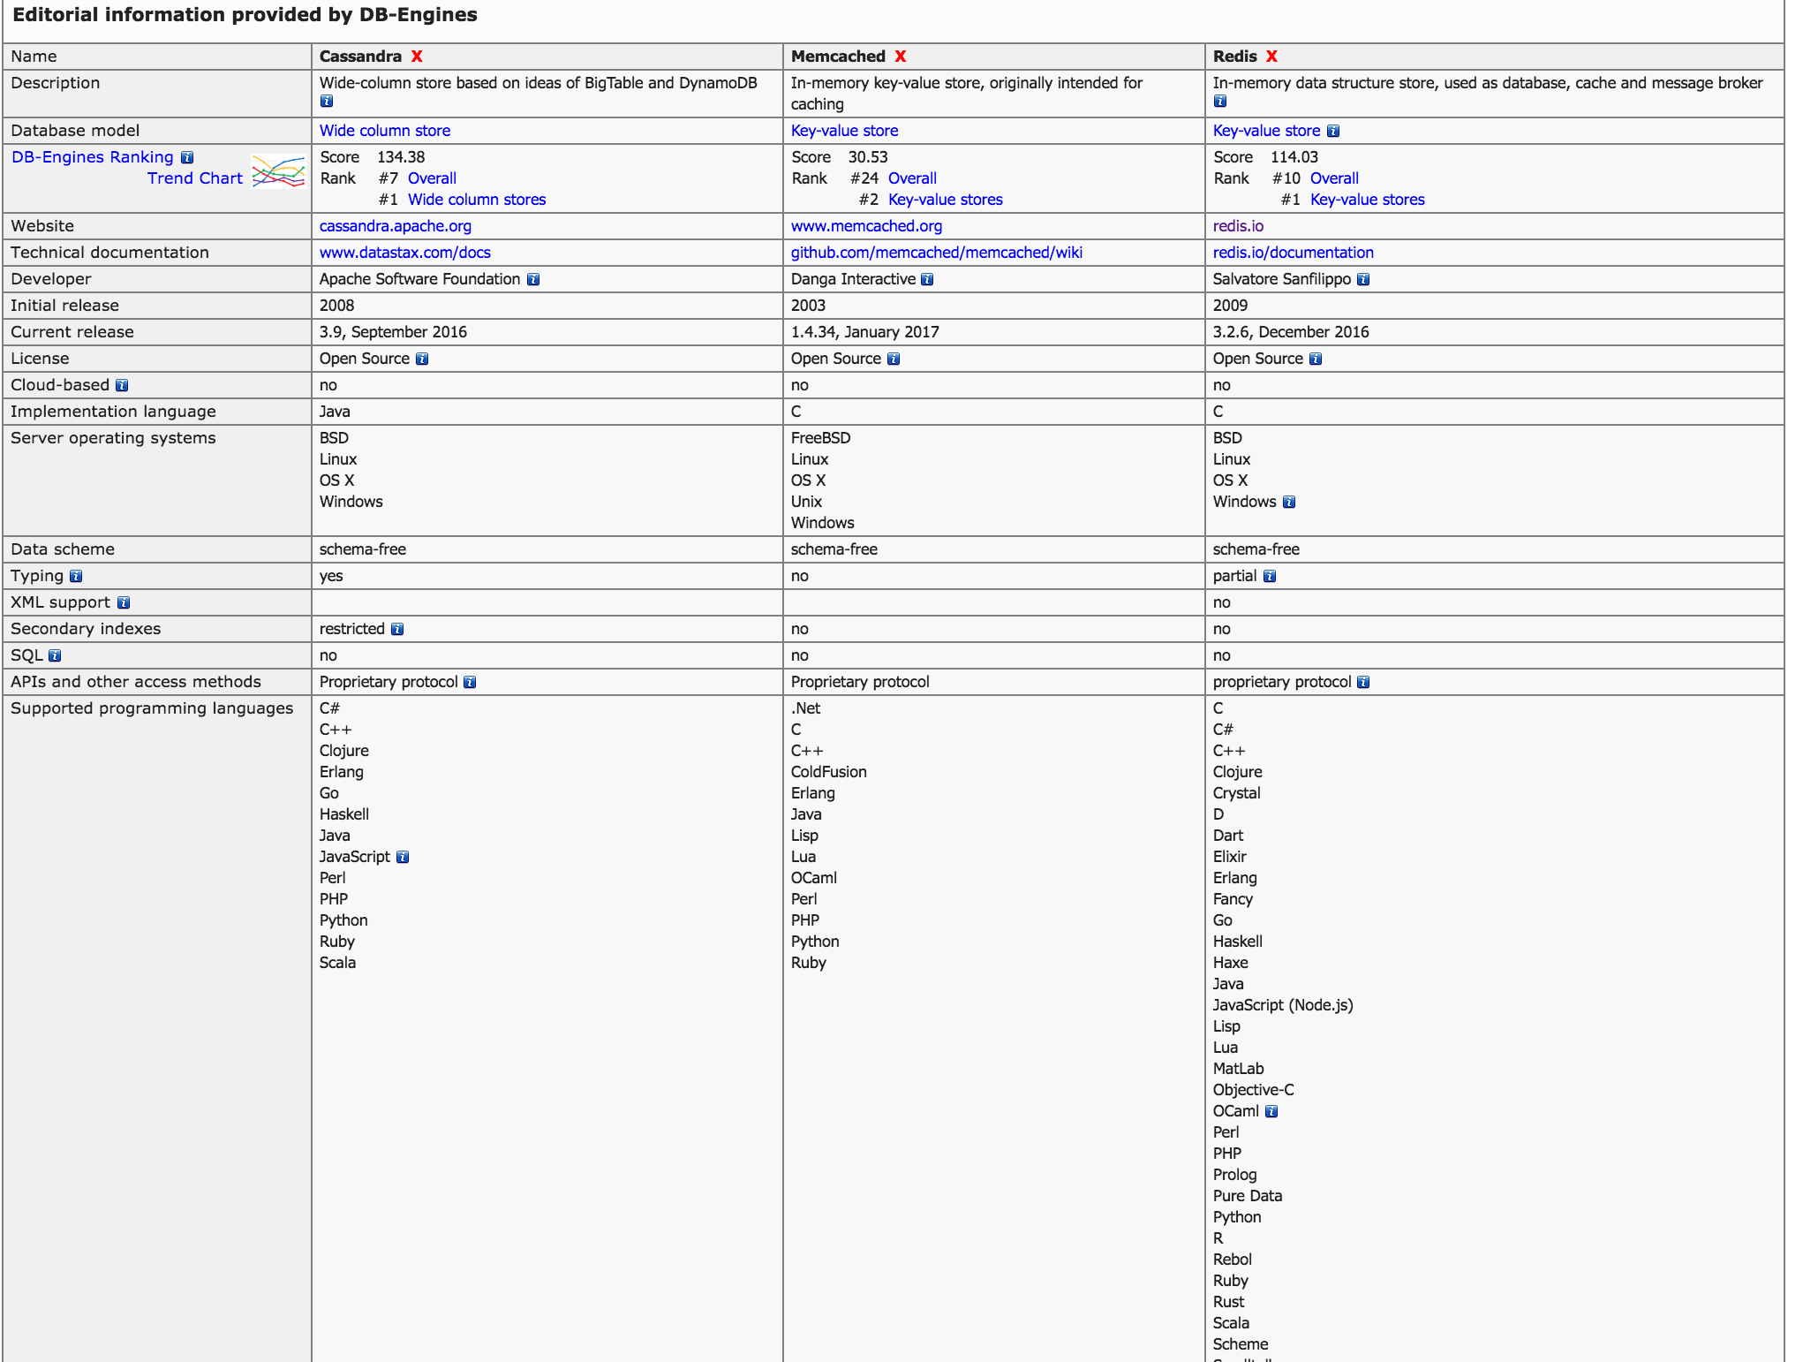
Alternatives

Slide 11
Live Demo
https://github.homedepot.com/Back-Office-And-In-Aisle-Systems/CL_Receiving_Router
https://github.homedepot.com/StoreInventoryFreight/CL_StoreSettings
https://github.homedepot.com/CustomerDelivery/DeliveryRedisCache

Slide 12
Links
https://redis.io
http://try.redis.io/
https://cloud.google.com/nodejs/resources/databases/redis
https://cloud.google.com/solutions/real-time/kubernetes-redis-bigquery
https://azure.microsoft.com/en-us/services/cache/
https://docs.microsoft.com/en-us/azure/redis-cache/cache-configure
http://theblasfrompas.blogspot.com/2017/04/spring-boot-application-for-pivotal.html
https://github.com/pivotal-cf/cf-redis-example-app
https://www.slideshare.net/mKrishnaKumar1/highly-scalable-caching-service-on-cloud-redis/3

Slide 13
Q & A

